Slide 1

A Human-In-The-Loop Approach to Decision Tree Building
By Zainab Aslam

Slide 2
Project background

Slide 3
Aims?

Slide 4
Existing applications

Slide 5
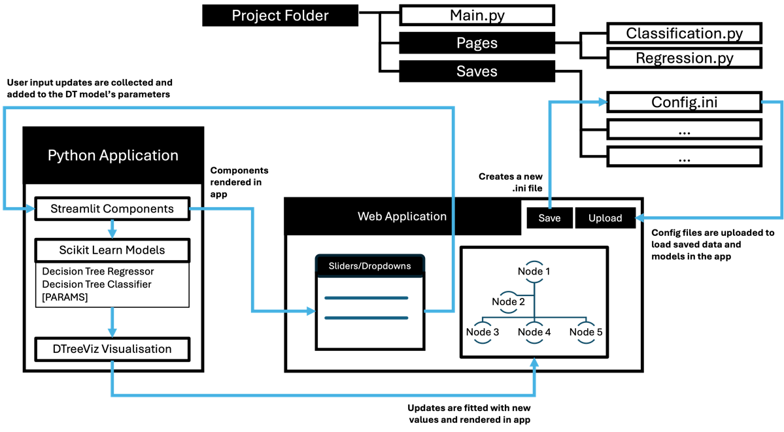
Technical Architecture

Slide 6
Implementation

Slide 7
Validation testing – what was found?
Some error handling mistakes
Questionability about underfitting thresholds
Dtreeviz breaks on high max_depth values for Wine Quality dataset

Slide 8
Performance testing
Regression has longer loading times than classification – could be due to the characteristics behind continuous features
Larger datasize sizes or larger max_depth sizes create a longer loading time

Slide 9
Demo

Slide 10
Limitations+Results

Slide 11
My thoughts

Slide 12
Summary

